Slide 1
ProstaTe Awareness EvenIng
St Dominic’s Social Centre- 22nd October 2026

Slide 2
Programme
Welcome and Introductions
Prostate- It’s function and what can go wrong
PSA testing – it’s benefits/limitations and value
If PSA is raised- the diagnostic process for prostate cancer
Making sense of the diagnosis, decision making and the value of peer support
Break-Q&A prep
Q&A
Close

Slide 3
All about the
Prostate
Eve Richards
Surgical Care practitioner

Slide 4
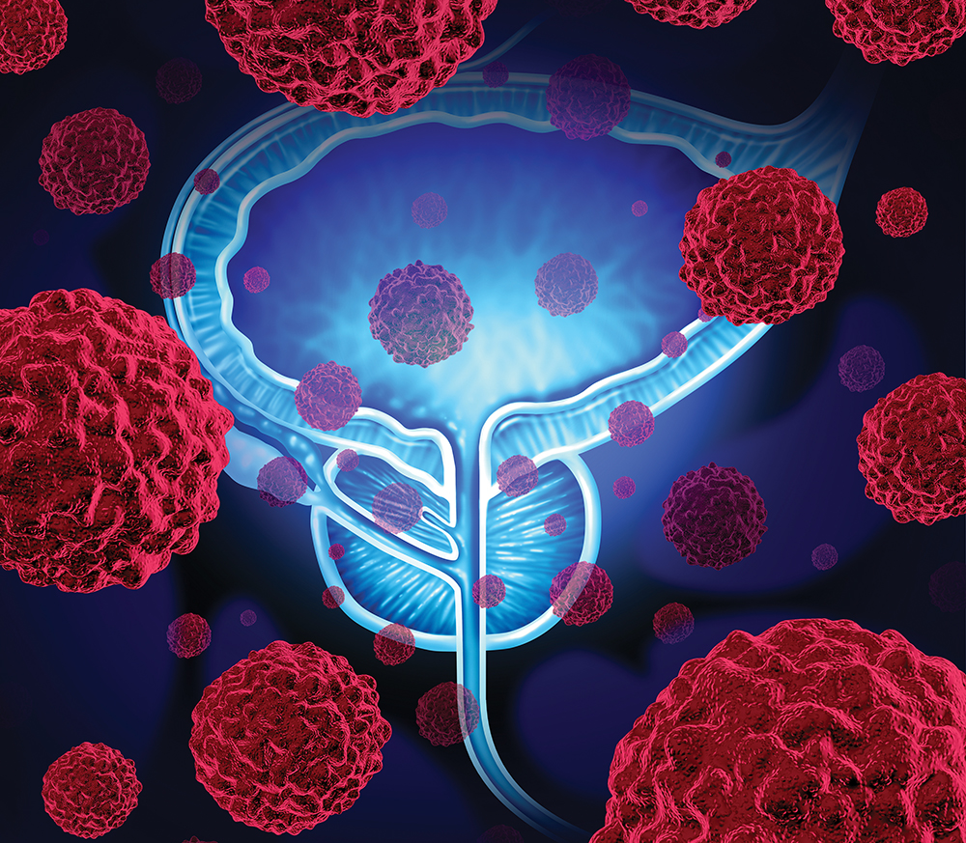



Agenda
Where is it?
What does it do?
Conditions that can affect it
This Photo by Unknown Author is licensed under CC BY
This Photo by Unknown Author is licensed under CC BY-SA

Slide 5
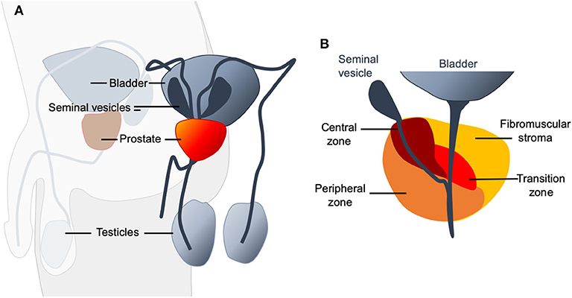
Where is it?
The Prostate is a small gland found only in men. It sits just below the bladder and in front of the rectum.
A useful way to picture its position is to think of it being wrapped around the first part of your water pipe as it leaves your bladder.
It is roughly the size of a walnut in younger men and commonly gets larger as men get older.
This Photo by Unknown Author is licensed under CC BY

Slide 6
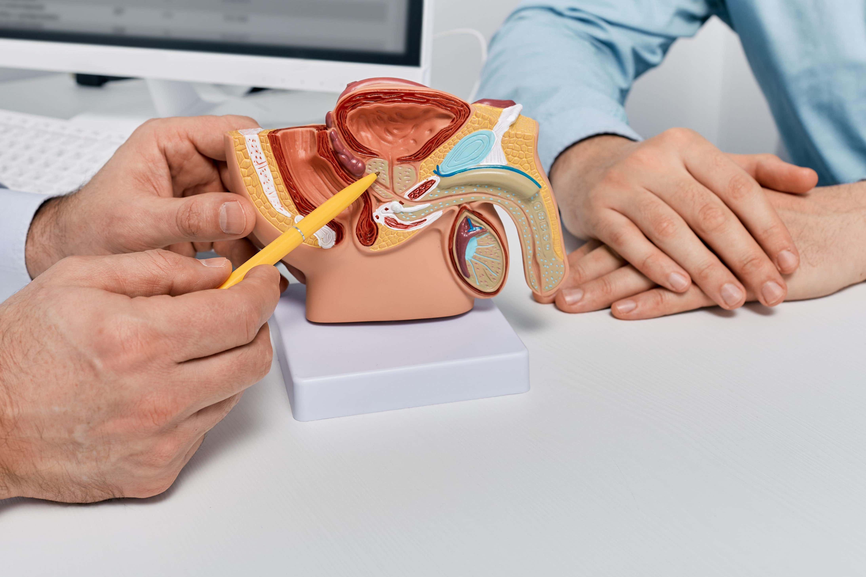
What does it do?
The prostate also has an important relationship with urination because the urethra (water pipe) runs directly through it. This is why changes in the prostate can affect both peeing and sexual function.
The prostate is a part of the male reproductive system. Its main function is to produce some of the fluid that makes up the semen. Think of sperm as the passengers, and semen as the fluid that carries and supports them.
During ejaculation, muscles within the prostate contract and help push this fluid into the urethra, where it mixes with fluid from the seminal vesicles and sperm from the testicles. This forms semen.

Slide 7


3 Main conditions that can affect the Prostate
Benign Prostatic Hyperplasia (BPH)
Prostatitis
This Photo by Unknown Author is licensed under CC BY
Prostate Cancer
This Photo by Unknown Author is licensed under CC BY-SA-NC

Slide 8
Benign Prostatic Enlargement (BPH,BPE)
Symptoms can include:
Benign means this isn’t cancer
Needing to pass urine more often.
Getting up several times in the night.
Having difficulty starting flow, weak or slow stream.
Stopping and starting flow.
Feeling that the bladder hasn’t completely emptied.
As men get older the prostate commonly gets bigger. If this happens it can start to squeeze or narrow the water pipe, making it harder for urine to leave the bladder.
Having an enlarged prostate does not mean its cancer.
Having cancer does not mean you have an enlarged prostate.
Notes:
(These don’t have designer IDs since they were based off the default master slides already in the deck.

Slide 9
Prostatitis
Symptoms can include:
Prostatitis is not cancer
Pain or discomfort around the prostate, pelvis, lower back or between the testicles or anus.
Pain or burning when passing urine.
Need to pass urine more frequently.
Have difficulty passing urine.
This simply means inflammation of the prostate. Unlike BPE, prostatitis can affect men at any age and is more common in younger and middle-aged men.
Sometimes it is caused by a bacterial infection.
In other cases, there is no infection, but the prostate and surrounding areas become inflamed and irritated.
Notes:
(These don’t have designer IDs since they were based off the default master slides already in the deck.

Slide 10
Prostate cancer
Symptoms can include:
Early prostate cancer often causes no symptoms at all
Often none in the early stages.
Later symptoms can resemble an enlarged prostate.
These symptoms do not automatically mean cancer and are more commonly caused by other prostate conditions – but should be checked.
Prostate cancer is caused by cells within the prostate growing in an abnormal and uncontrolled way.
It is the most common cancer in men in the UK, and the risk increases as men get older.
Notes:
(These don’t have designer IDs since they were based off the default master slides already in the deck.

Slide 11


Key message
Prostate cancer is often treatable, particularly when found early. Don’t ignore changes or concerns – Speak to your GP.

Slide 12


Thank you
Eve Richards
Urology Surgical Care Practitioner
This Photo by Unknown Author is licensed under CC BY
This Photo by Unknown Author is licensed under CC BY-SA

Slide 13
PSA Testing and Screening For Prostate Cancer
Mark Seaton,
Founder, Stafford & Surrounds Prostate Cancer Support Group

Slide 14


What is PSA
PSA stands for Prostate Specific Antigen
PSA is a protein produced by the prostate and is found in the blood.
A PSA blood test therefore simple measures the amount of PSA in the blood.
A PSA blood test is not a test for prostate cancer.
The PSA level is an indicator of prostate health.

Slide 15
So why do PSA testing?
If the PSA is within the normal range, this can in most cases rule out cancer (around 85%)
Some prostate cancer do not secrete PSA, and some men secrete abnormally low levels – so 15% of prostate cancer will be missed by a PSA test.
A raised PSA, does not indicate cancer, it could be BPH or proctitis.
PSA is also increased as a result of recent sexual activity, strenuous physical activity, any local pressure on the prostate e.g rectal exam, cycling, constipation.
The level of PSA however, alongside other information may raise the level of suspicion of cancer during the diagnostic period.
PSA is used following cancer treatment to monitor for recurrence.

Slide 16
Prostate Cancer Screening
There is currently no national screening programme.
The limitations of PSA testing have been discussed. PSA is therefore not a reliable tool for mass (population level)screening for prostate cancer.
Know your prostate cancer risk by using PCUK risk checker.
  Men over 50
  Men of black ethnicity
  Men with a family history of prostate cancer
  Men with a family history of cancers associated with BRCA2 gene
  Men of 50 can request a PSA test from their GP. The GP will discuss the rationale for the request and associated risk information before agreeing (or not) to a test.
  Men can attend local PSA testing sessions ( e.g those organized locally by Lions)
  A clinical trial ( Transform) is currently underway to identify a better screening test.

Slide 17
What happens if your PSA is raised?
The diagnostic process
Eve Richards

Slide 18

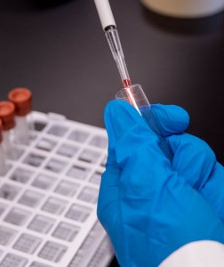

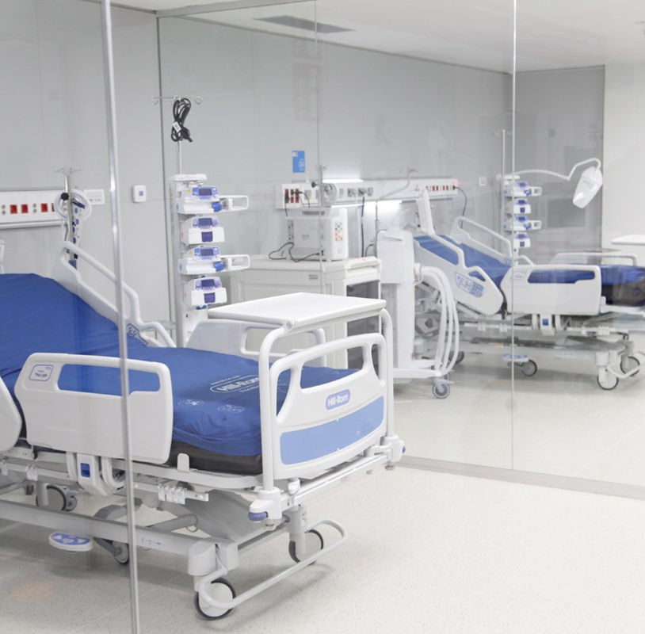
Agenda
Considerations for your GP
Referral to Urology
Multiparametric MRI
Prostate Biopsies
This Photo by Unknown Author is licensed under CC BY-NC-ND

Slide 19
GP Considerations
If your PSA is raised your GP will look at the following factors:
Actual PSA level
Age
Urinary symptoms
Family history
Previous PSA results
Does the prostate feel abnormal?

Slide 20
Referral to Urology
If there is sufficient concern, your GP will make a referral to the Urology department.
This does not mean you have cancer – just that you will be investigated promptly.

Slide 21
MRI
An MRI gives a detailed picture of the prostate and looks for areas that look suspicious. It can not tell us if it is cancer – only if there is a suspicious area.
A PIRADS score is used to classify the likelihood of cancer if a suspicious area is found.
PIRADS 1-2 – Low likelihood
PIRADS 3 – Uncertain.
PIRADS 4 -5 – Increasingly suspicious.

Slide 22
Prostate Biopsies
A prostate biopsy is usually advised for PIRADS 3 and above. This is because the only way to tell if they are cancer cells is to look at the tissue under a microscope.
Small tissue samples will be taken transperineally (through the skin between the scrotum and back passage).
If the biopsies are positive, the pathology results will indicate the grade/aggressiveness of the cancer using a Gleason score.

Slide 23
PSA raises the suspicion – MRI investigates – Biopsy confirms.

Slide 24
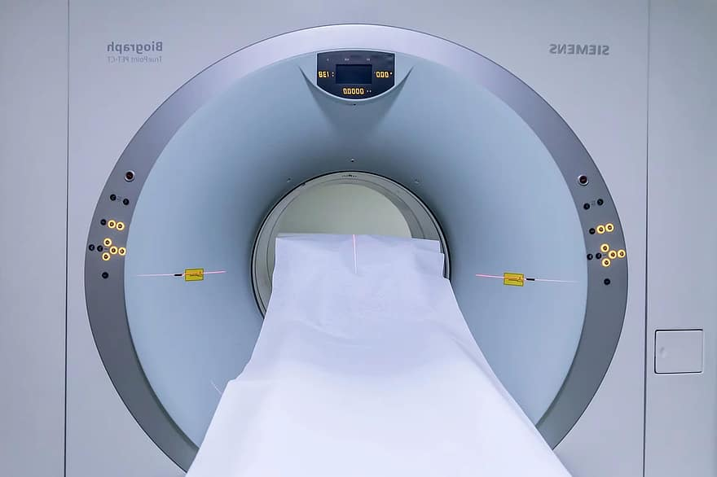
Thank you
Eve Richards
Urology surgical care practitioner
This Photo by Unknown Author is licensed under CC BY-SA
This Photo by Unknown Author is licensed under CC BY-SA-NC

Slide 25
Making sense of the diagnosis and the value of peer support
Mark Seaton

Slide 26
Numbers, numbers, numbers
PSA level
PIRADS score ( from MRI- 1-5)
Gleason Grade group (1-5)
Gleason score ( sum of 2 most common grades found)
T-stage (TNM)
CPG ( Cambridge prognostic group)- combines PSA, gleason and T-stage to give a prognostic score (1-5)

Slide 27
Gleason grade and score
From a biopsy sample the pathologist will grade the cancer cells based on how abnormal they look and how aggressive they are likely to be. Group 1 is least aggressive and 5 is most aggressive.
The gleason score is the sum of the 2 most common grades of cancer cells identified in the biopsy ( 6-10)

Slide 28
Examples (CRUK)
Gleason score 6 (3+3) Grade group1- most of the cells look similar to normal cells- The cancer is likely to grow very slowly if at all.
Gleason score 7 (3+4) Grade group 2- most cells look similar to normal, but there are some higher grade cells present- the cancer is likely to grow slowly
Gleason score 7 (4+3) Grade group 3- more of the cancer cells are less like normal- and therefore likely to grow at a moderate rate
Gleason 9/10 (grade group 5- the majority of cells look very abnormal- the cancer is likely to grow quickly.

Slide 29
TNM- Tumour, Nodes and Metastases
T- staging T2 means confined to the prostate, T3a and T3b are locally advanced. T3a breached the prostate capsule but no other organs, T3b- spread to seminal vesicles. T4 means more widespread.
Nodes- means lymph nodes and this will indicate whether the MRI has picked up any cancer in lymph nodes
Metastases are sites where the cancer has spread ( T4) and how many.
So my cancer was T3aN0M0

Slide 30
The Challenge
The emotional distress for both suffers and partners
The lack of any real explanation to enable ordinary people to understand what it all means.
Treatment choices- will depend on the individuals overall age, health and the numbers. But often choices will have to be made, but these are BIG choices and require an understanding of the above.
Treatment regret- European estimates suggest that up to 40% of men later regret the choice they made!

Slide 31
Some treatment options
Active surveillance- offered in low grade cancers- gleason 6 or 7(3+4)- no immediate treatment deemed necessary, but 3 monthly PSA and annual MRI(minimum).
Radical prostatectomy- surgical removal. Urinary incontinence is likely at least for 3-4 months, Erectile dysfunction(ED) common. Time off work!
Hormonal treatment + radiotherapy. Hormonal treatments block the effect of testosterone and result in loss of muscle mass, weight gain, mood swings , hot sweats. This shrinks the tumour prior to radiotherapy- typically 20 sessions 5 days a week for 4 weeks. The radiotherapy can cause bowel damage, leading to faecal urgency and incontinence, and also ED. Shorter courses of radiotherapy SABR are now being rolled out ( 5 days)
Not all treatment options will be offered by your local hospital!

Slide 32
The value of peer support
Talk to people that have been through it. Both men and their partners
They can help explain the numbers and diagnosis
Listen to their stories and see what resonates with you- make the right decision for you!
Signpost to resources and other treatment options that may only be available at a regional level. ( focal therapies)
Tackle Prostate Cancer supports 164 peer support groups around the country of which there are 3 in Staffordshire.
  Stafford and Surrounds
  North Staffordshire (S-o-T)
  Burton

Slide 33
Before we take a break!
Post it notes for questions
Please talk to our team
Back by………

